Slide 1
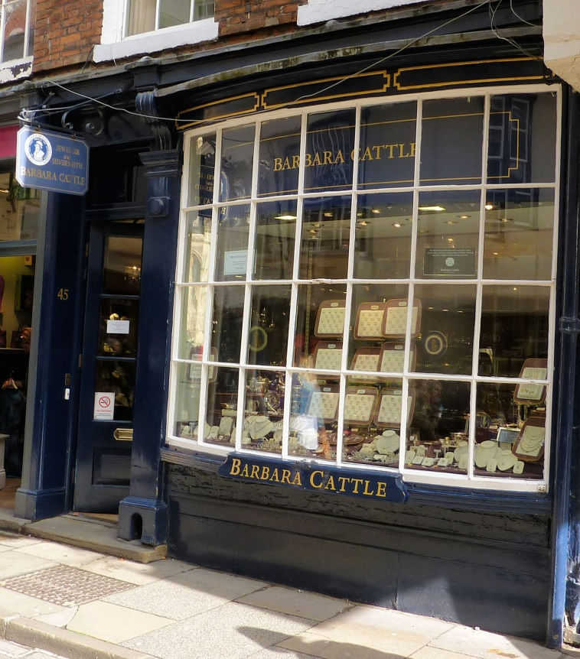
Your humble and obedient Servant Providing luxury goods and services in 18th c York

Slide 2
‘In short the politeness of the gentlemen, the richness of the dress, and remarkable beauty of the ladies, and, of late, the magnificence of the room they meet in cannot be equalled, throughout, in any part of Europe ...... and it will be no vanity for me to say, that though other cities and towns in the kingdom run far beyond us in trade, and the hurry of business, yet, there is no place, out of London, so polite and elegant to live in as the city of York.’
Dr Francis Drake, Eboracum, 1736

Slide 3
Interior of York Assembly Rooms in Blake Street 1759 Artist unknown Image courtesy of the York Museums Trust: http://yorkmuseumstrust.org.uk: Public domain

Slide 4
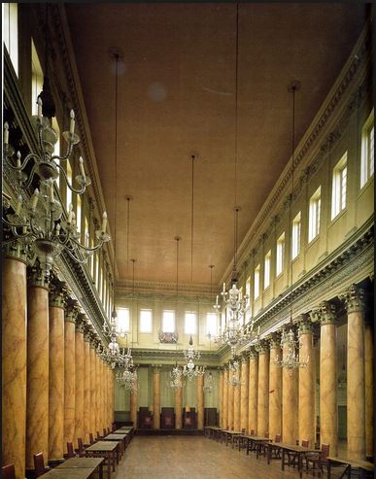
Assembly Rooms
Image courtesy of York Conservation Trust

Slide 5
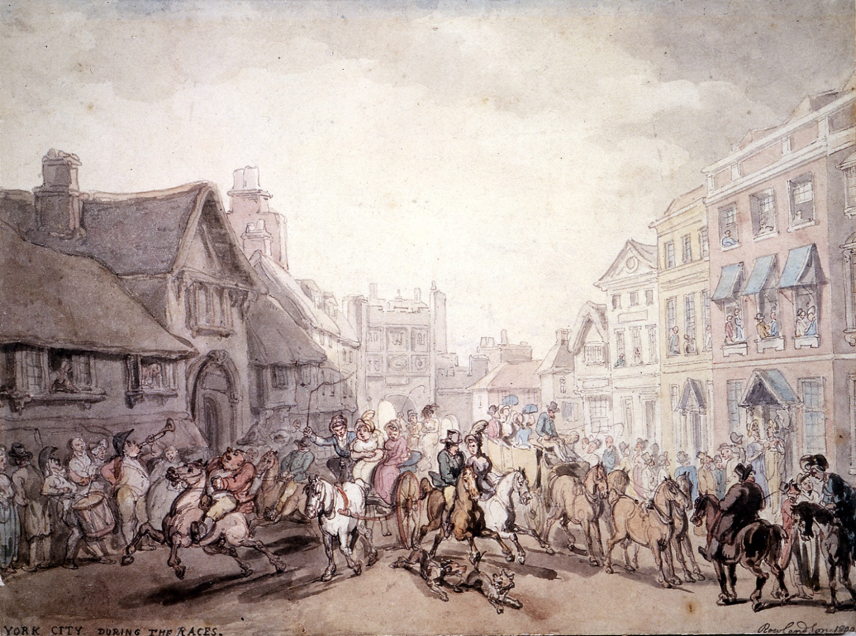
York City during the Races, Thomas Rowlandson 1800
Image courtesy of York Museums Trust :: http://yorkmuseumstrust.org.uk ::
Public Domain

Slide 6
Execution day at York 1820 Thomas Rowlandson
Image courtesy of York Museums Trust :: http://yorkmuseumstrust.org.uk :: Public Domain
Notes:
Even less genteel is this image of the follow up of the Assizes with three individuals on their way out of Micklegate Bar to the Tyburn at Knavesmire, close to the race course. Note that those found guilty of some crime share the waggon with their coffins. It looks like a child has been dropped or knocked over in the bottom right hand corner. Again the building on the right is artist’s imagination.

Slide 7
What luxury goods and services were available
Their sources
How goods were obtained
How retailers attracted buyers

Slide 8
Occupation | Numbers
Book seller/stationer | 5
Carver & gilder | 2
Clockmaker | 1
Confectioner | 6
Furrier | 2
Glass painter & stainer | 1
Gold/silversmith, jeweller | 6
Haberdasher | 8
Hairdresser | 5
Limner/artist | 1
Music seller | 1
Sculptor | 1
Silk mercer | 6
Tea merchants | 10
Tobacconist | 1
Watchmaker | 4
Some luxury suppliers
From 1784 York directory (n= 204) and 1784 parliamentary election list of York voters (n= 1,306)

Slide 9
Women – sample from 1702 to 1798
Occupation | Number | Number free
Milliner | 41 | 27
Mantua maker (dressmaker) | 16 | 3
Stay maker | 3 | 0
Linen/woollen draper | 5 | 0
Other occupations were: tea/grocer china 3; haberdasher 2; hatter 2; mercer 2; perfumer 2; quilter 2; seamstress 1; optician 1; three of whom were free. Total 83

Slide 10
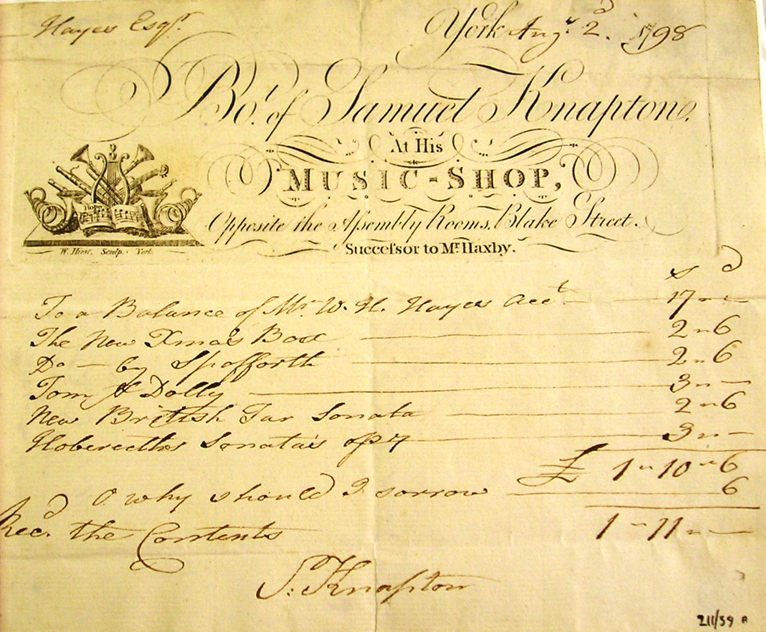
Invoice from Samuel Knapton’s Music Shop in Blake Street, 1798
Image courtesy of York Museums Trust :: http://yorkmuseumstrust.org.uk :: Public Domain

Slide 11
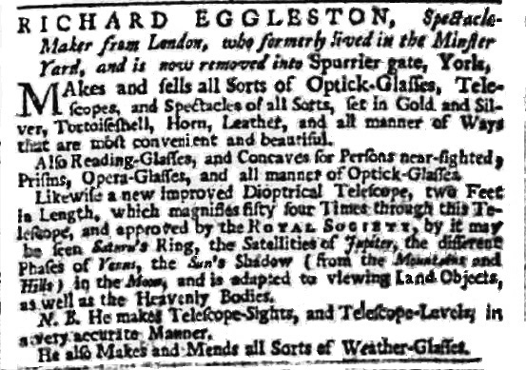
York Courant 28 October 1740

Slide 12
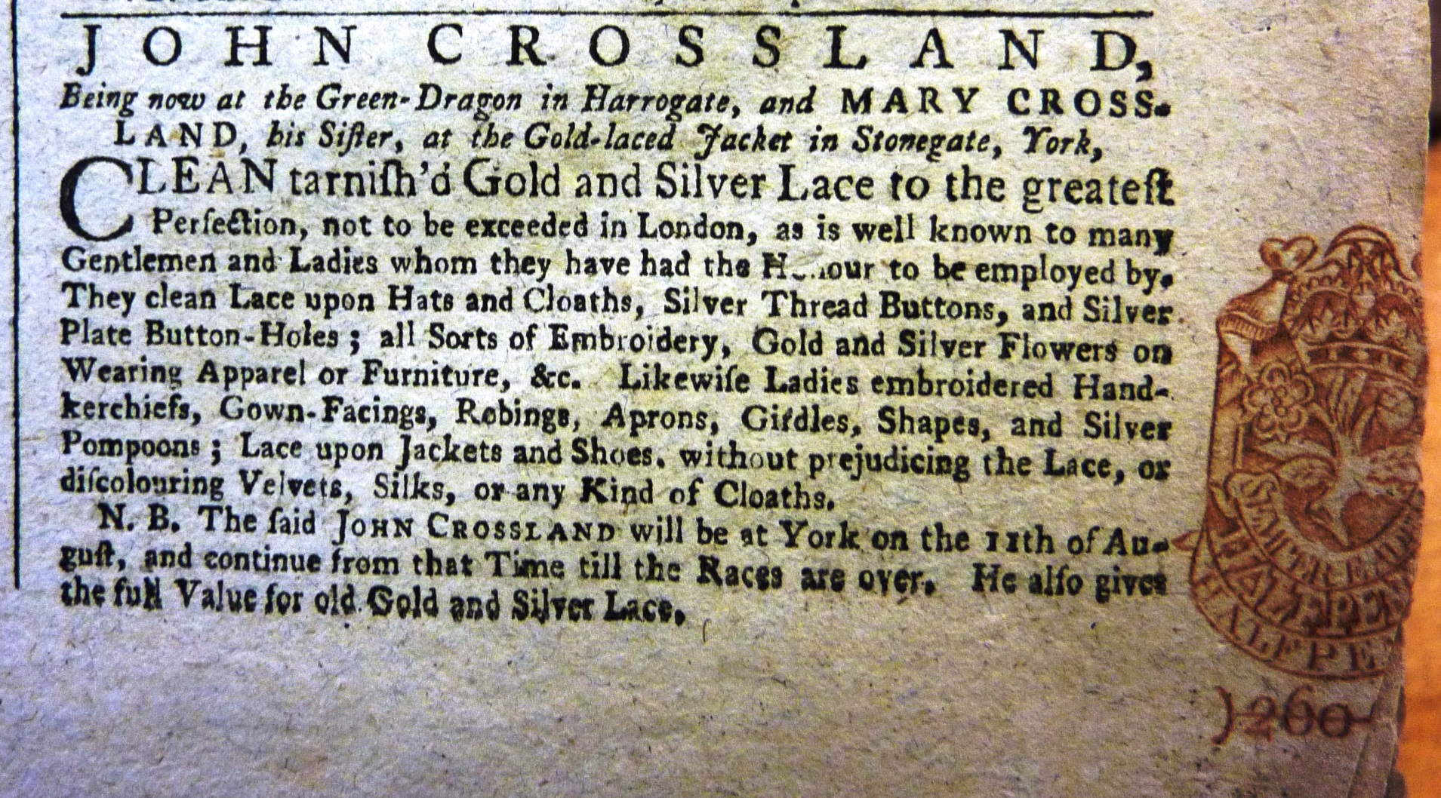
York Courant 12 August 1760

Slide 13
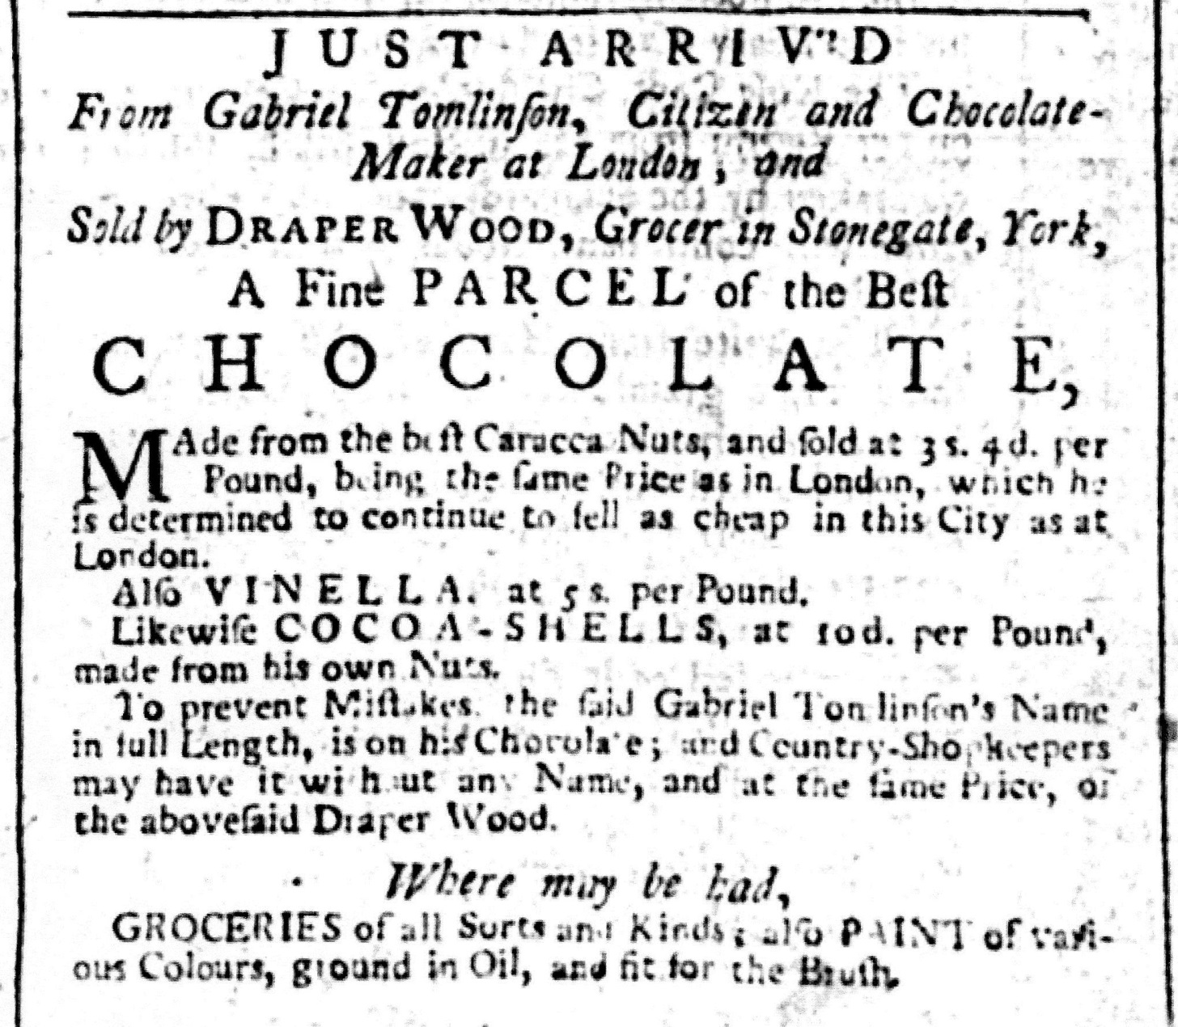
York Courant 12th June 1750

Slide 14
F. ATKINSON
“Begs leave to recommend to the Ladies an elegant Specimen of the SPOTTED IRISH POPLINS, in a very improved State for SUMMER RIDING DRESSES and GREAT-COATS: Also a very beautiful Article, called the CANTERBURY MUSLINS, and some Pieces of striped and clouded CHAMBRAY and SILK GAUZES, which he has just brought from London. – Articles intended to form an elegant DRESS and HALF-DRESS for the Summer Season, and have never before been introduced in this City, - Purples, Greens, Sapphires, Pale Buff, and the Prince’s Brown, will be the prevailing Colours at the ensuing BIRTH-DAY. The preparations are extremely brilliant: Embroidered Silks and Irish Stuffs for the Gentlemen, and the Produce of SPITALFIELDS for the Ladies’ wear will predominate.”
York Courant 18 May 1790

Slide 15
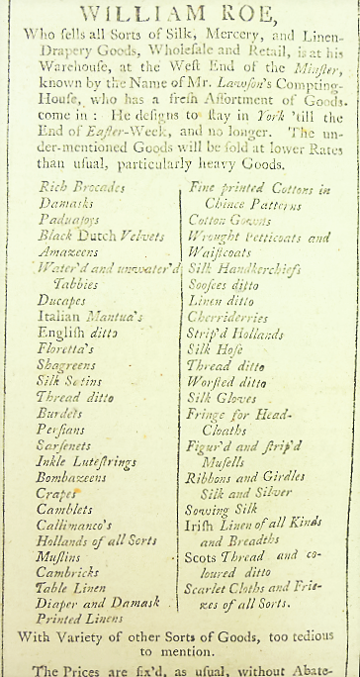
York Courant
28 March 1738

Slide 16
P. GOULLET JEWELLER from LONDON (son to Mr. Goullet, Jeweller, who keeps the great Pearl Necklace-Shop in Leicester-Fields). At Mr. Gibson’s, Apothecary, opposite the White Swan in Petergate, YORK. Makes and sells all Sorts of JEWELLING work as neat and as cheap as any where in London. Though he keeps no open shop, he has great Variety of Jewels ready made, in Diamonds, French paste &c, &c, in the most elegant Taste. Ladies and Gentlemen may have their Jewels newset after the newest Fashion, he having work’d in the principal Shops in London, and lastly for Mr. Dutens Jeweller to the Prince of Wales. N.B. Orders from the Country will be executed with all possible Diligence. Mourning Rings, very neat. Money for old Jewels, Gold, or silver.”
York Courant 7 January 1755

Slide 17
This is to give Notice to all Gentlemen and Ladies,
That ANDREAS MUSSARD, Native of the Republic of
Geneva LIMNER in MINATURE, is come to this City to exercise his Art for a short Time. He was Disciple of the late celebrated SENORA ROSALBA, in Venice; has an extraordinary Talent for Portraits of Resemblance, for Bracelets and History Pieces; and not only for grown Persons, but particularly for the extraordinary striking Likeness of Children. He also teaches to draw. He has been in all the Courts of Europe. If there be any that chose to favour him with their Commands, he may be heard of at Mr. James Griffith’s, Stay-Maker near Ouse Bridge in Micklegate, York.
York Courant 12 June 1770

Slide 18
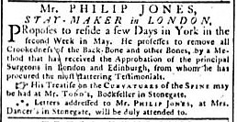
York Courant 17 April 1790

Slide 19
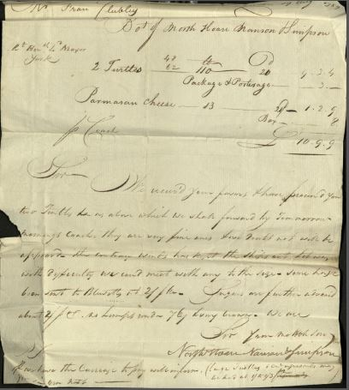
Invoice to Francis Clubley for purchase and transport of two turtles, August 1789
York City Archives, Chamberlains’ Vouchers

Slide 20
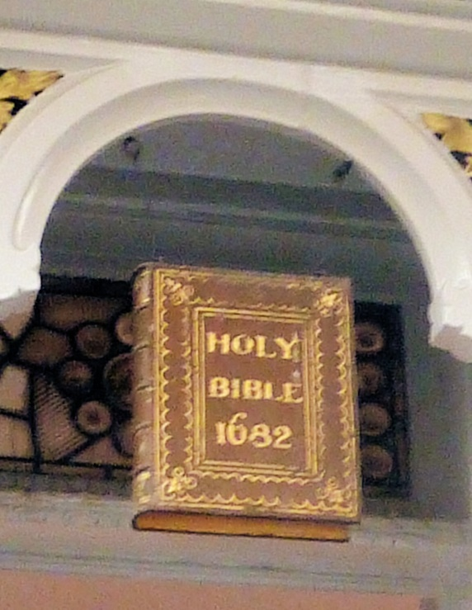
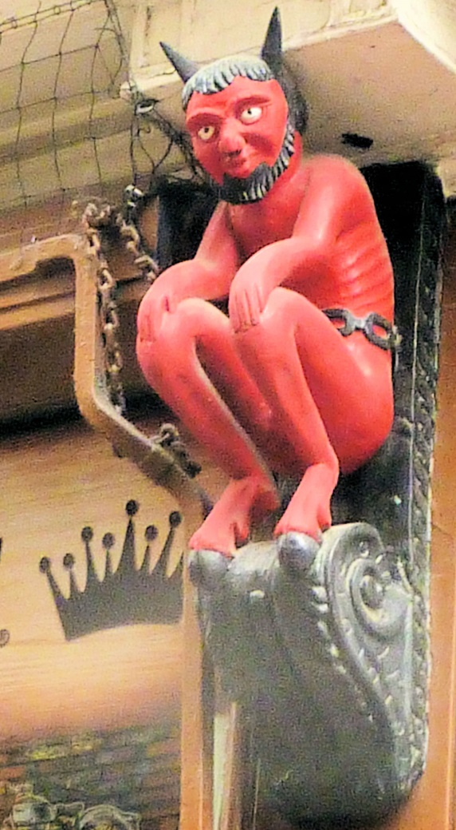
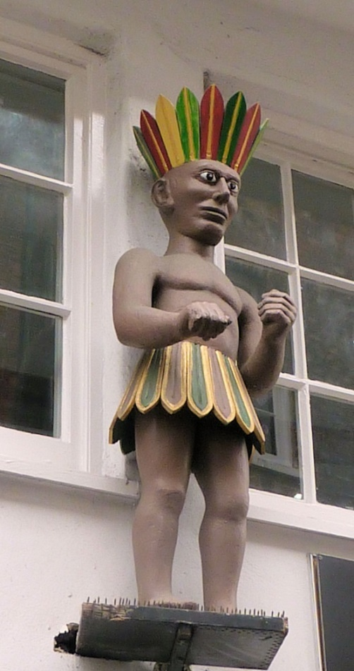
Todd’s Bookshop,
Stonegate
Red Devil,
Thomas Gent printer
Coffee Yard/ Stonegate
Petergate

Slide 21
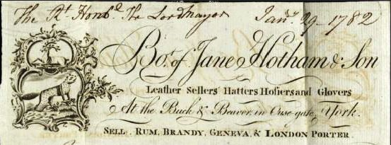
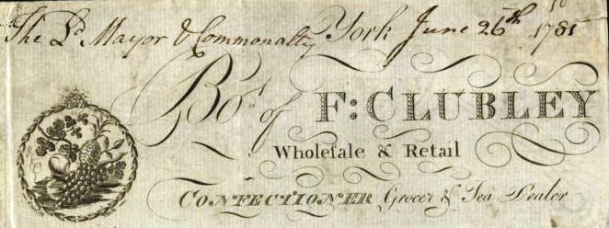
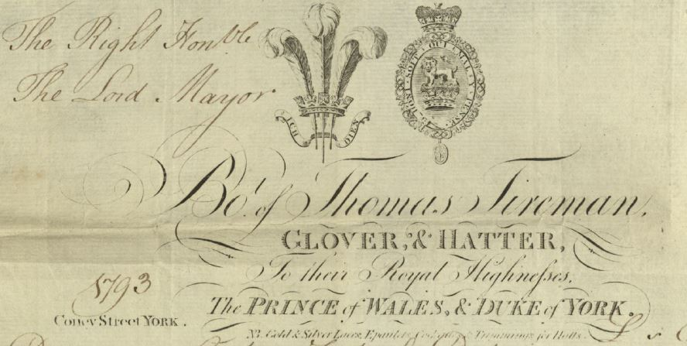
Billheads of invoices
presented to the City Council
Notes:
Another way to attract customers was to have a link with royalty. As you see Thomas Tireman glover and hatter claims to have supplied items to the Prince of Wales and the Duke of York. This 1794 invoice to the Lord Mayor itemises a hat each for the York Waites by name. Presumably the Prince of Wales had bought something on one of his earlier visit to the Races in York

Slide 22
‘To the NOBILITY, GENTRY, and the Public in general’ tailor & habit maker, 1780
‘This is to acquaint all Gentlemen and Ladies’ John Crossland, cleans gold and silver, 1756
‘To the Curious in WATER COLOURS’ Riley’s paints, W. Tesseyman, bookseller, 1789
‘Begs leave to acquaint the Ladies’ Margaret Cook, mantua maker, 1755
‘Humbly offers his most respectful services’ EM’MIS, French stay maker from London, 1780
‘With all due respects acquaints the Public’ Barry Drew, haberdasher, 1755
‘Desires to acquaint his Friends’ John Peirson, mercer, London, 1755
‘Begs leave to acquaint the Public’ William Beckwith, mercer 1752
Targeted forms of address from the York Courant
Notes:
To the Ladies and others
Meanest sort

Slide 23
Conclusions:
A wide range of luxury goods and services were available at different times provided by both local and visiting retailers.
Luxury items were made locally but many were also be sourced from a variety of British and overseas suppliers.
Retailers promoted their goods with attractive window displays, prominent sign boards, newspaper advertisements and elaborate bill heads. A royal association added further status
Many advertisements were targeted at the “Nobility and Gentry”, others at the “Public”, others at “Friends” and others at specialist buyers.
Links with London, Paris, and further afield gave status to the goods and the trader

Slide 24
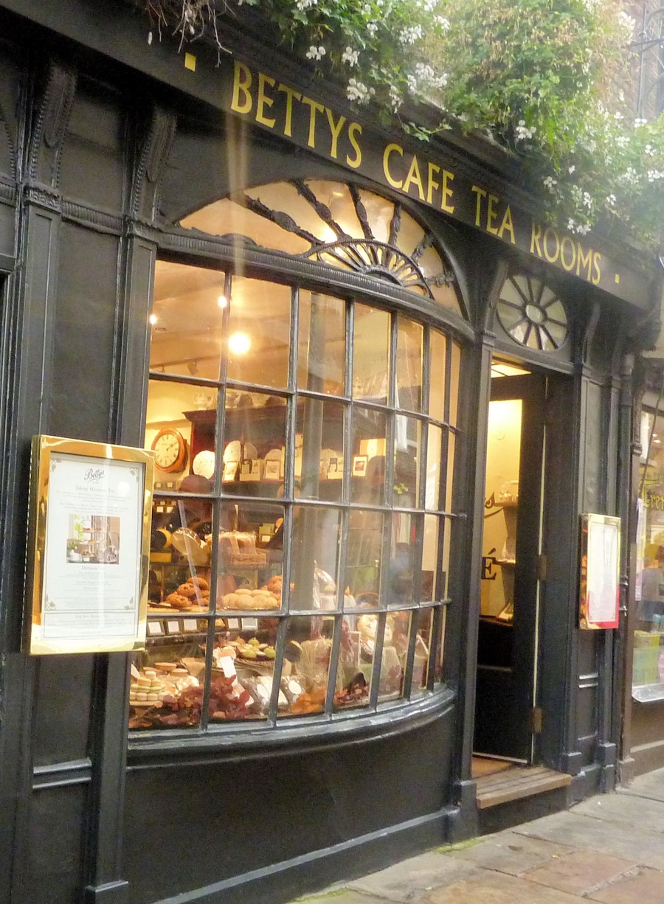
Thank you for your most gracious and genteel attention

